Slide 1
This is the coolest powerpoint that you will ever see
You know it’s cool because it’s got all the hilarious examples of things you shouldn’t do when you’re making a powerpoint. It’s important to think about design when you’re making any kind of visual argument, a poster or a brochure or even a regular text document. Why is it that I require your formal papers to be in 12 point times new roman with certain margins?
12 point is an appropriate size on paper but not on a projector in front of the class where you have to see it from far away. Can you guys in the back read this? The back isn’t very far away in this room even.
Notes:
- Wall of text –don’t just read your slides –make sure the font size is big enough to read

Slide 2
This is the coolest powerpoint that you will ever see
You know it’s cool
It’s got all the hilarious examples of things you shouldn’t do when you’re making a powerpoint.
It’s important to think about design when you’re making any kind of visual argument
  A poster
  or a brochure
  or even a regular text document
Why is it that I require your formal papers to be
  12 point Times New Roman
  1 inch margins ?
Notes:
-adding bullets doesn’t fix the problem. It’s still the same too much text –alignment (this has left right AND centered text. No good)

Slide 3
Fonts, style and rhet. situation
What does this font say?
What does this font say?
Dude check out this font
You are cordially invited to…
This is a serif font. This is a sans serif
Notes:
-Fonts carry meaning –Times is safe, boring –Comic sans is unprofessional/cliché –script fonts and novelty fonts by rhetorical situation. –serif fonts more formal/old fashioned. Sans serif more modern.

Slide 4
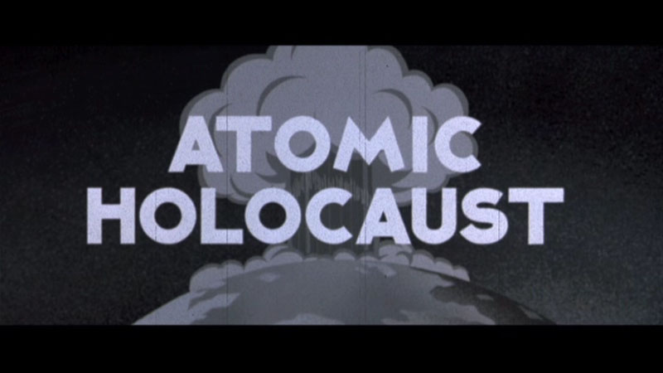
Always have a supercool background
And Supercool text to go on top of it
Yellow is easy to see, right?
Notes:
-the background is not the important message. -color scheme should work together –need to see text, but not get a migraine looking (clashing) –be careful of red and green for color blind audience

Slide 5

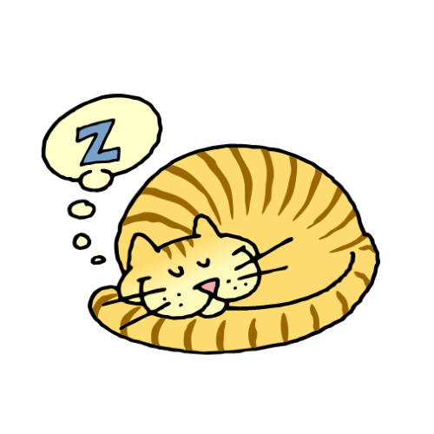
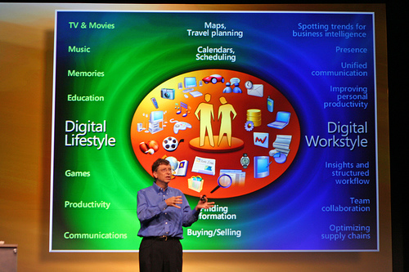
Pictures make everything better
Notes:
-motion = distracting and childish. Wastes time. -pictures should be 1. relevant visual arguments, 2. the right resolution (not blown up fuzzy) 3. big enough to see (That’s bill gates in the corner with a bad pp slide)

